Slide 1
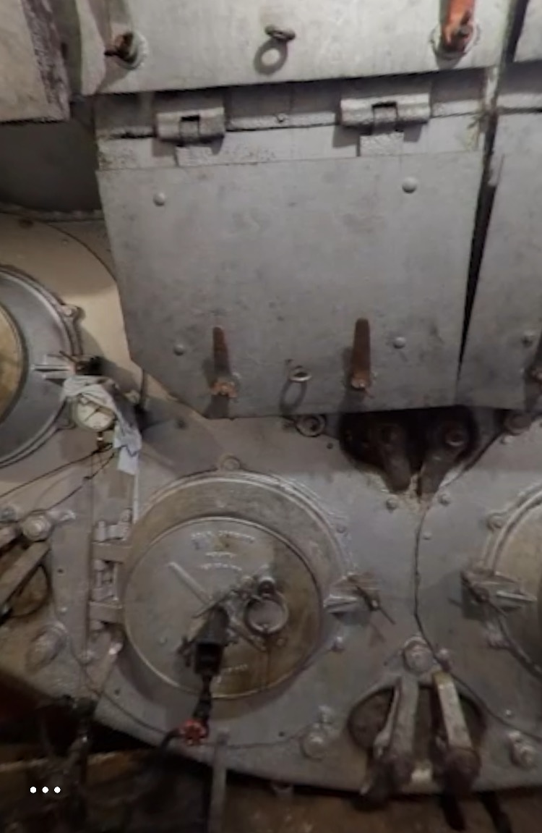
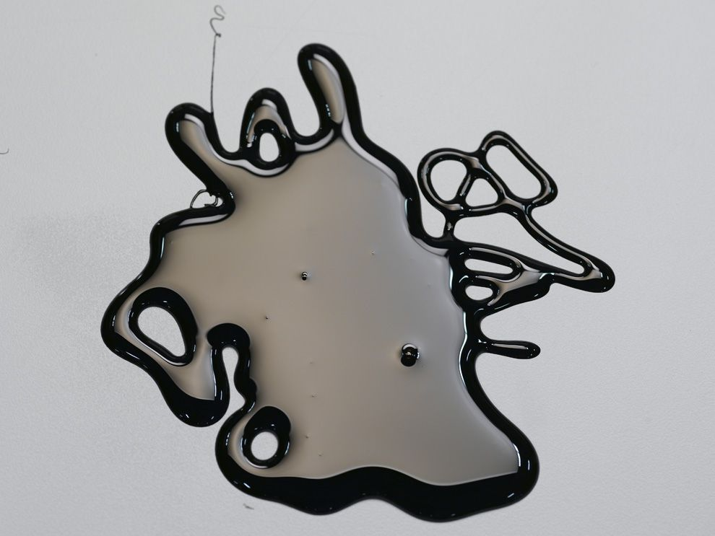
The Boiler Room
Name: _____________________
How is energy transferred in the boiler room?
________________________________________________________________________________________________________
________________________________________________________________________________________________________
____________________________________________________
Steam molecules have ___________ energy.
🔥+ =
Fire has _______________ energy.
+☀️ + 💨= 🔥
oil
heat
air
fire
Oil has _______________ energy.

Slide 2
Answered
Name: _____________________
Steam molecules have mechanical energy.
How is energy transferred in the boiler room?
Oil, which has chemical energy, is combined with heat and air. This causes a reaction so that the chemical energy is transferred to heat energy in the form of fire. The fire heats the water in the boiler room. The water molecules move faster so that they transfer to steam. The steam has mechanical energy. In this reaction, heat energy is transferred to mechanical energy.
🔥+ =
Fire has heat energy.
+☀️ + 💨= 🔥
oil
heat
air
fire
Oil has chemical energy.
Notes:
Answer Key

